Slide 1
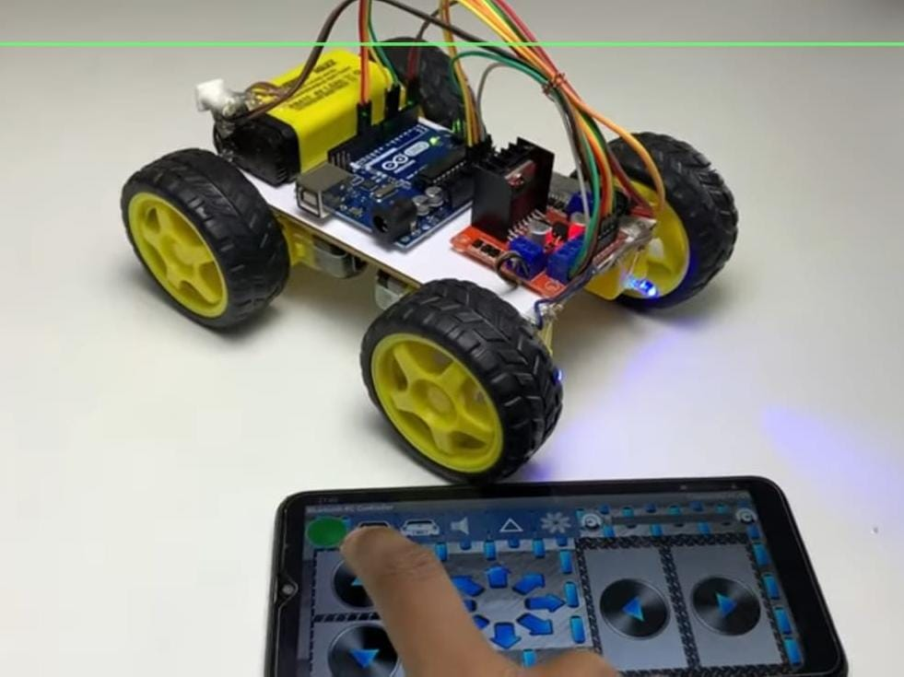
Bluetooth Controlled RC Car
Team Members:
Siddharth S
Mohith J
Navienkumar C
Shri Shyam A J
College Expo Project

Slide 2
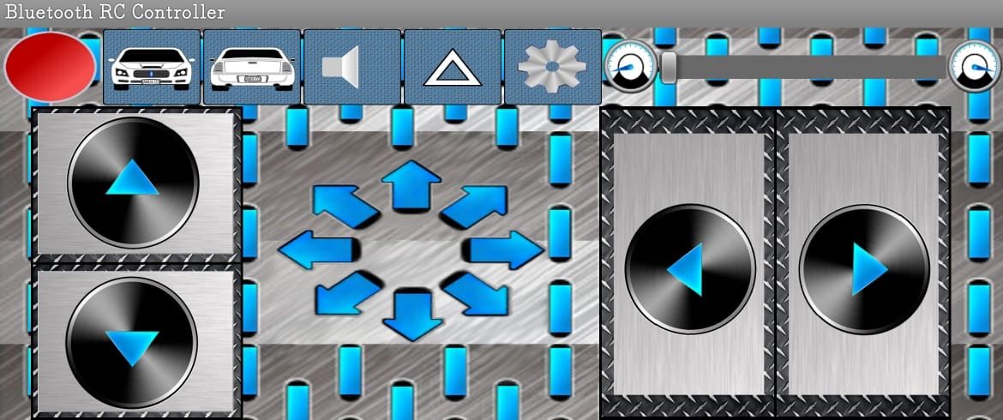
Introduction
• A Bluetooth-controlled RC car built using Arduino UNO
• Controlled wirelessly using a smartphone app
• Demonstrates integration of hardware and software in robotics

Slide 3
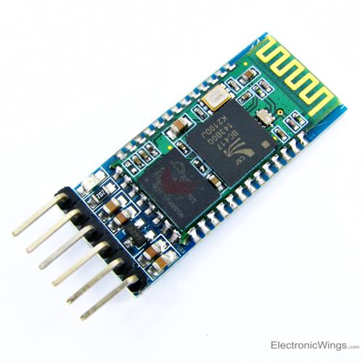
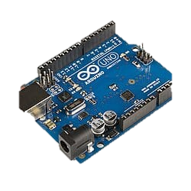
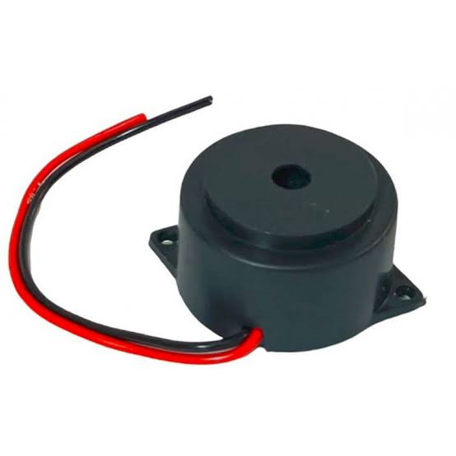
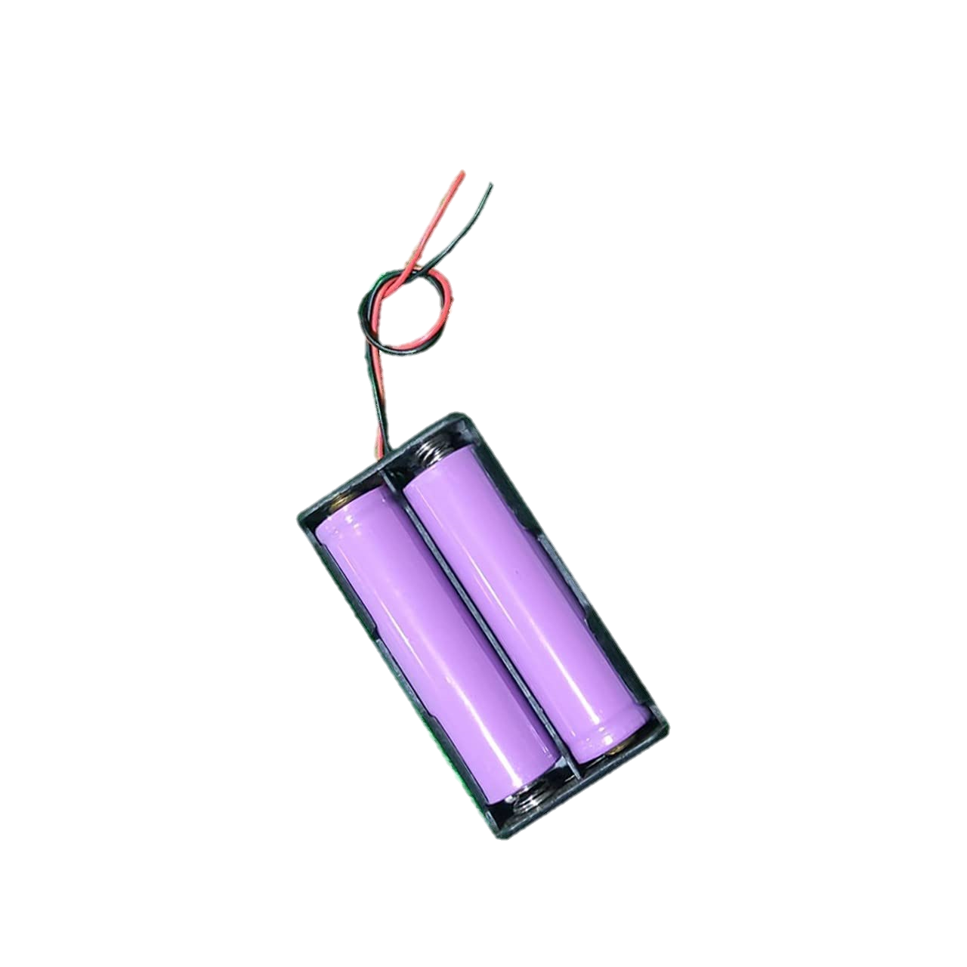
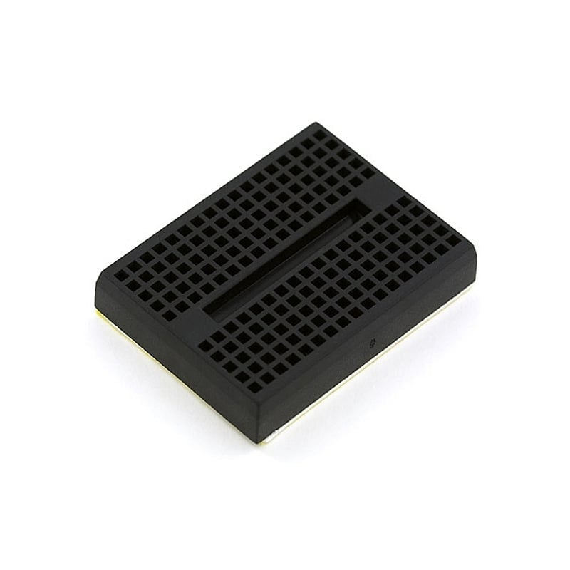
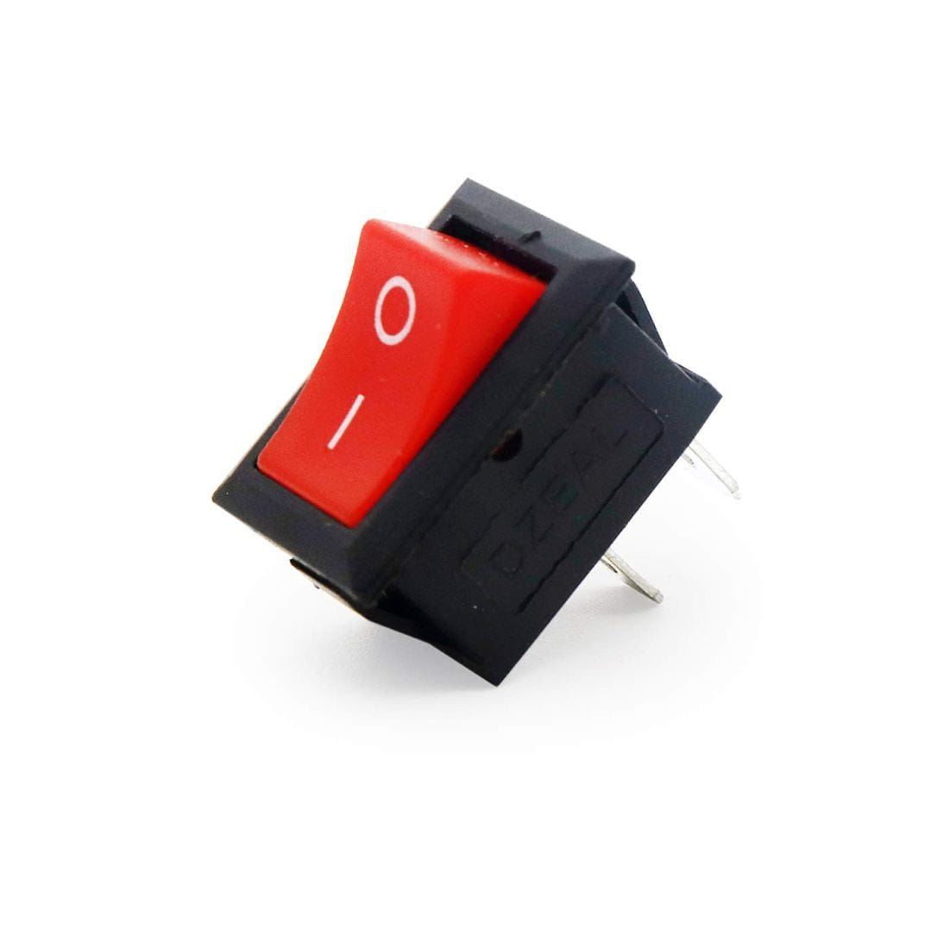
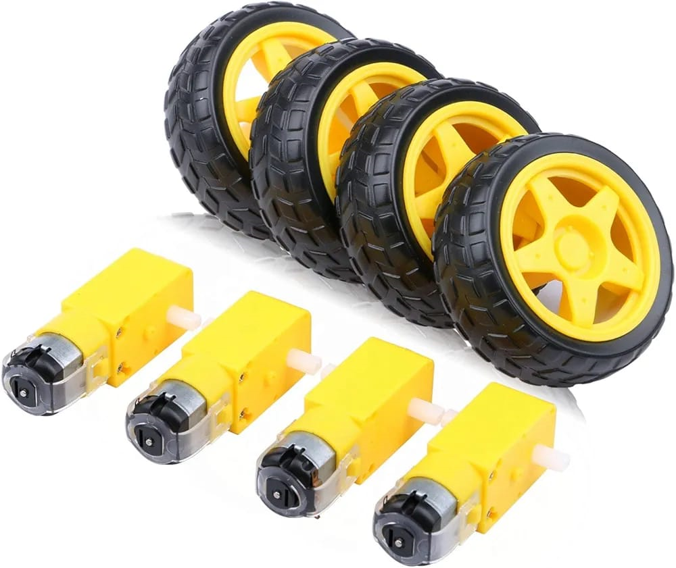
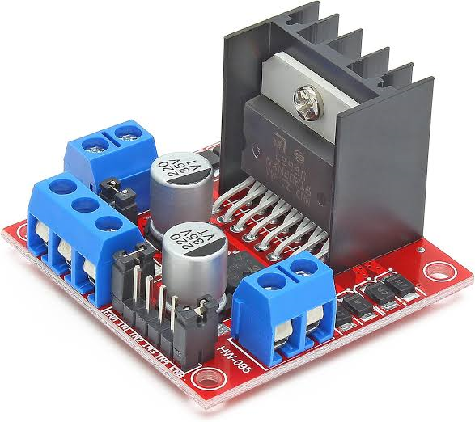
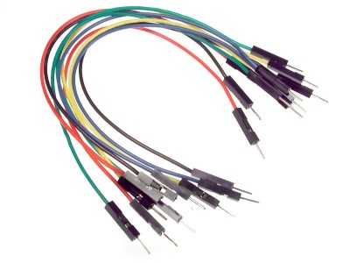
Components Used
• Arduino UNO
• L298N Motor Driver
• 4 x 6V DC Motors
• 2 x Lithium-ion Batteries
• HC-05 Bluetooth Module
• Buzzer
• 4 x LEDs
• Jumper Wires
• Switch
• Mini bread board

Slide 4
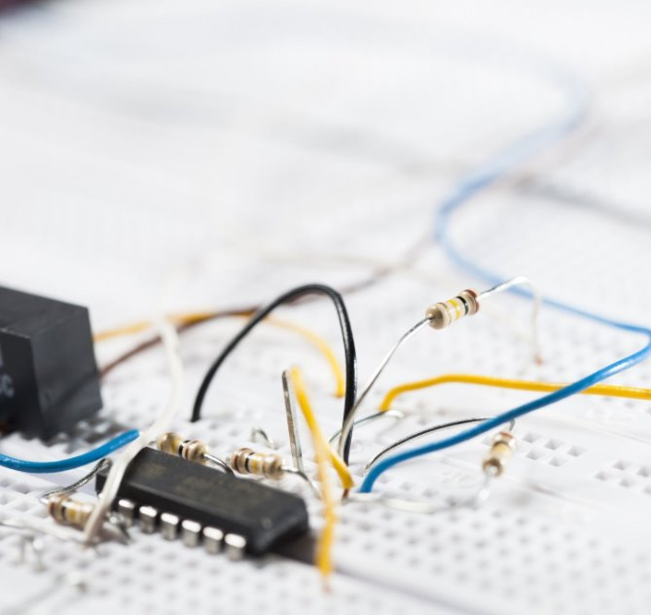
Working Principle
• The smartphone sends commands via Bluetooth
• Arduino UNO processes the received commands
• L298N motor driver controls the motors accordingly
• Car moves forward, backward, left, or right
• LEDs and buzzer used for indication

Slide 5
Advantages
• Low-cost and easy to build
• Portable and battery-operated
• Wireless control using a smartphone
• Good learning project for robotics and IoT

Slide 6
Applications
Wireless Control of Vehicles – It shows how Bluetooth can be used to remotely control cars, robots, or small vehicles.
Robotics & Automation – Useful in making mobile robots that can be guided wirelessly for tasks like delivery or surveillance.
Educational Purpose – Great for learning about Arduino, motor drivers, sensors, and wireless communication.
Prototyping for Smart Cars – Basic idea behind remote-controlled or even autonomous vehicle systems. Can be upgraded with sensors for advanced robotics

Slide 7
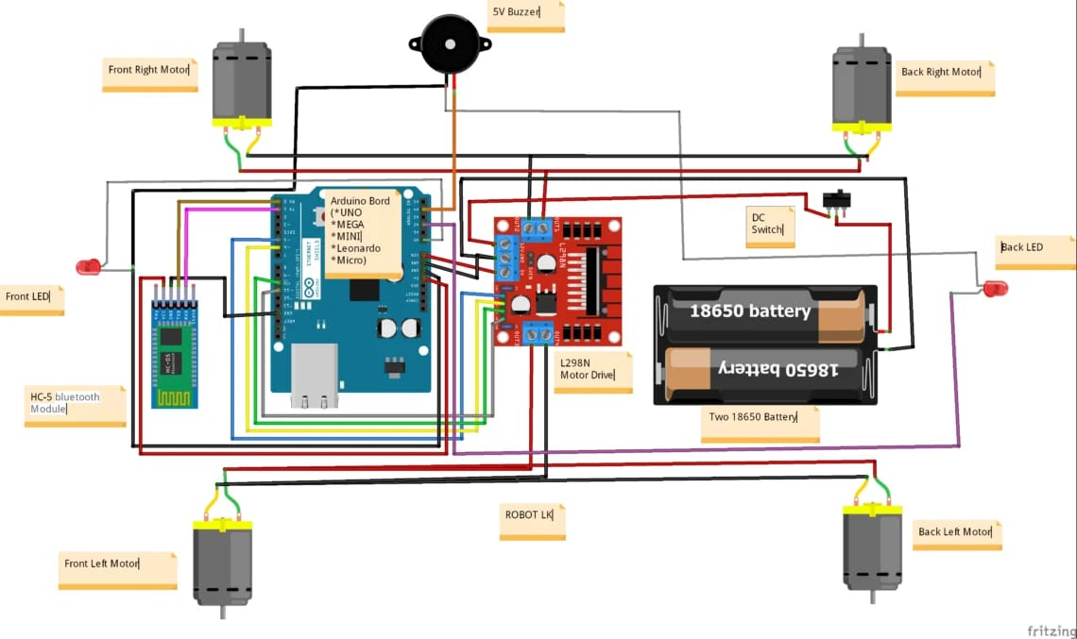
Circuit Diagram

Slide 8
Arduino Code (Part 1)
#include <AFMotor.h>
// Define motor pins
#define motorA1 7 // IN1
#define motorA2 6 // IN2
#define motorB1 5 // IN3
#define motorB2 4 // IN4
#define ENA 8 // PWM for motor A
#define ENB 3 // PWM for motor B
void setup() {
Serial.begin(9600); // Start Bluetooth communication
pinMode(motorA1, OUTPUT);
pinMode(motorA2, OUTPUT);
pinMode(motorB1, OUTPUT);
pinMode(motorB2, OUTPUT);
pinMode(ENA, OUTPUT);
pinMode(ENB, OUTPUT);
}

Slide 9
Arduino Code (Part 2)
void loop() {
if (Serial.available()) {
char command = Serial.read(); // Read command from Bluetooth
controlMotors(command);
}
}
void controlMotors(char command) {
switch (command) {
case 'F': // Move Forward
digitalWrite(motorA1, LOW);
digitalWrite(motorA2, HIGH);
digitalWrite(motorB1, HIGH);
digitalWrite(motorB2, LOW);
analogWrite(ENA, 255); // Set speed (max)
analogWrite(ENB, 255); // Set speed (max)
break;
case 'B': // Move Backward
digitalWrite(motorA1, HIGH);
digitalWrite(motorA2, LOW);
digitalWrite(motorB1, LOW);
digitalWrite(motorB2, HIGH);
analogWrite(ENA, 255);
analogWrite(ENB, 255);
break;

Slide 10
Arduino Code (Part 3)
case 'L': // Turn Left
digitalWrite(motorA1, LOW);
digitalWrite(motorA2, HIGH);
digitalWrite(motorB1, LOW);
digitalWrite(motorB2, HIGH);
analogWrite(ENA, 255);
analogWrite(ENB, 255);
break;
case 'R': // Turn Right
digitalWrite(motorA1, HIGH);
digitalWrite(motorA2, LOW);
digitalWrite(motorB1, HIGH);
digitalWrite(motorB2, LOW);
analogWrite(ENA, 255);
analogWrite(ENB, 255);
break;
case 'S': // Stop
digitalWrite(motorA1, LOW);
digitalWrite(motorA2, LOW);
digitalWrite(motorB1, LOW);
digitalWrite(motorB2, LOW);
break;
default: // Default case
break;
}
}

Slide 11
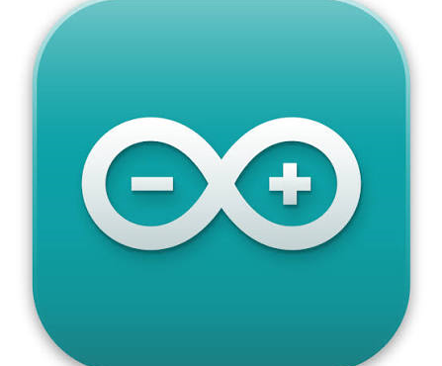

Software Used
• Arduino IDE
• Tinkercad
Arduino IDE: Arduino IDE (Integrated Development Environment) is the official software used to write, compile, and upload programs (sketches) to Arduino boards. It supports C/C++ and provides libraries for sensors, motors, and communication modules.
Tinkercad: Tinkercad is an online simulation and circuit design tool developed by Autodesk. It allows users to design circuits, simulate Arduino projects, and test code without physical hardware.

Slide 12
Conclusion
This project demonstrates the use of Arduino and Bluetooth in building a simple RC car.
It provides practical knowledge in embedded systems, wireless communication, and robotics.
-- PPT by S Sajjan

